Slide 1

Brand identity proposal / 01
Dayform
Studio
Brand identity proposal
Prepared for a neighborhood café
Fictional studio and concept studies. Scope, fees and timing are examples.
01 / 12
Notes:
Fictional studio and concept studies. Scope, fees and timing are examples.

Slide 2
Dayform Studio
Brand identity proposal / 01
A local café,
a clear identity
The café should feel familiar on the street and easy to recognize on a cup. This proposal connects the physical space with the small things people take away.
Working assumption: an independent café preparing its first identity. The brief needs confirmation.
Fictional studio and concept studies. Scope, fees and timing are examples.
02 / 12
Notes:
Fictional studio and concept studies. Scope, fees and timing are examples.

Slide 3
Dayform Studio
Brand identity proposal / 01
What the identity
needs to do
01
Feel at home
An approachable visual language for everyday visits, without losing a distinct point of view.
02
Work in the real world
Clear decisions for the sign, menu, takeaway packaging and a small digital presence.
Fictional studio and concept studies. Scope, fees and timing are examples.
03 / 12
Notes:
Fictional studio and concept studies. Scope, fees and timing are examples.

Slide 4
Dayform Studio
Brand identity proposal / 01
Warm. Direct.
A little unexpected.
Uncoated paper, a confident red and generous typography. A simple system that can carry a menu as comfortably as a window sign.
A proposed direction for discussion, not an approved identity.
Fictional studio and concept studies. Scope, fees and timing are examples.
04 / 12
Notes:
Fictional studio and concept studies. Scope, fees and timing are examples.

Slide 5

Dayform Studio
Brand identity proposal / 01
The everyday
coffee run
A concept study in familiar materials and one unmistakable color.
Original AI-generated packaging study. No real client or delivered project.
Fictional studio and concept studies. Scope, fees and timing are examples.
05 / 12
Notes:
Fictional studio and concept studies. Scope, fees and timing are examples.

Slide 6
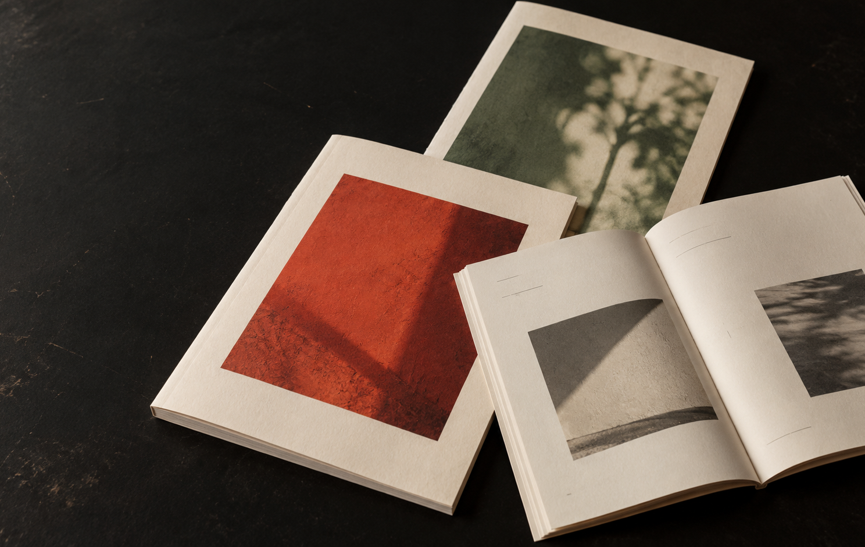
Dayform Studio
Brand identity proposal / 01
A small
print series
A second concept study explores how a few consistent decisions can hold different stories together.
Original AI-generated print study. No existing publication or commissioned work.
Fictional studio and concept studies. Scope, fees and timing are examples.
06 / 12
Notes:
Fictional studio and concept studies. Scope, fees and timing are examples.

Slide 7
Dayform Studio
Brand identity proposal / 01
A focused
set of tools
01
Identity foundations
Primary identity, supporting marks and a practical color and type system.
02
Everyday applications
A menu layout, takeaway cup and bag concepts, and a window-sign direction.
03
Digital essentials
A small set of social layouts and a landing-page art-direction sheet.
04
A usable handover
Organized artwork, file guidance and a concise identity guide.
Fictional studio and concept studies. Scope, fees and timing are examples.
07 / 12
Notes:
Fictional studio and concept studies. Scope, fees and timing are examples.

Slide 8
Dayform Studio
Brand identity proposal / 01
How we work together
01
02
03
04
Understand
Explore
Develop
Prepare
A focused conversation about the café, its visitors and the decisions ahead.
Two visual directions, discussed together before one moves forward.
Refine the selected identity and test it on the agreed applications.
Check artwork, document the system and prepare the handover.
Fictional studio and concept studies. Scope, fees and timing are examples.
08 / 12
Notes:
Fictional studio and concept studies. Scope, fees and timing are examples.

Slide 9
Dayform Studio
Brand identity proposal / 01
A six-week first plan
An example schedule, subject to the agreed scope and timely feedback.
Week 1 | Brief and discovery
Weeks 2–3 | Visual directions and selection
Weeks 4–5 | Identity and applications
Week 6 | Final checks and handover
Fictional studio and concept studies. Scope, fees and timing are examples.
09 / 12
Notes:
Fictional studio and concept studies. Scope, fees and timing are examples.

Slide 10
Dayform Studio
Brand identity proposal / 01
Example investment
An illustrative fee for the sample scope. A real quote follows an agreed brief.
Discovery and direction | $1,800
Identity development | $4,800
Artwork and handover | $1,800
Example total | $8,400
Illustrative USD fees, not an offer. Tax, production and third-party costs are not included.
Fictional studio and concept studies. Scope, fees and timing are examples.
10 / 12
Notes:
Fictional studio and concept studies. Scope, fees and timing are examples.

Slide 11
Dayform Studio
Brand identity proposal / 01
What this scope covers
Included in this example
Agreed separately
One selected identity direction, two refinement rounds and the applications listed in this proposal.
Printing, photography, copywriting, website development and additional rollout work.
Fictional studio and concept studies. Scope, fees and timing are examples.
11 / 12
Notes:
Fictional studio and concept studies. Scope, fees and timing are examples.

Slide 12
Dayform Studio
The next
conversation
Confirm the brief, agree on the scope and choose a starting date.
Let’s review the proposal together
Fictional studio and concept studies. Scope, fees and timing are examples.
12 / 12
Notes:
Fictional studio and concept studies. Scope, fees and timing are examples.

